Slide 1
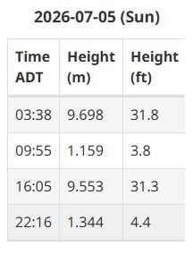
Start time: 8pm
Allocation: 150mt
High tide: 4:05pm
Sunset time: 9:11pm

Slide 2
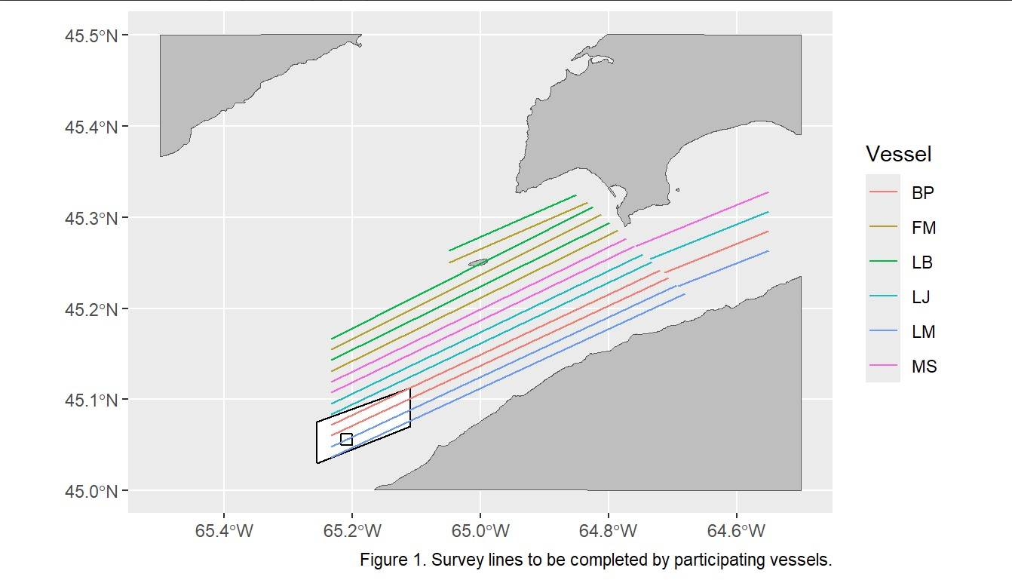
LB and FM will start with their northern lines.

